Slide 1
Machine Learning Foundations and Applications
Jiaul Paik

Slide 2
Today’s topics
Optimization for Deep Learning
Adaptive Gradient Descent
Adagrad
ADAM
Introduction to Deep Neural Nets
Feedforward Network

Slide 3
RECAP

Slide 4
Gradient Descent
Goal
Minimize a function w.r.t the parameters that the function contains
The error/objective function
$E=\sum_{i=1}^{m}{ {\left(y^{(i)}−F(x^{(i)})\right)}^{2}}$
$F →ML model$
Two objectives
Only minimum value of the function
Find the value of the parameters that will minimize the function
Training data
Input | Output
$$x^{(1)}$$ | $$y^{(1)}$$
$$x^{(2)}$$ | $$y^{(2)}$$
$$x^{(3)}$$ | $$y^{(3)}$$
$$x^{(4)}$$ | $$y^{(4)}$$

Slide 5
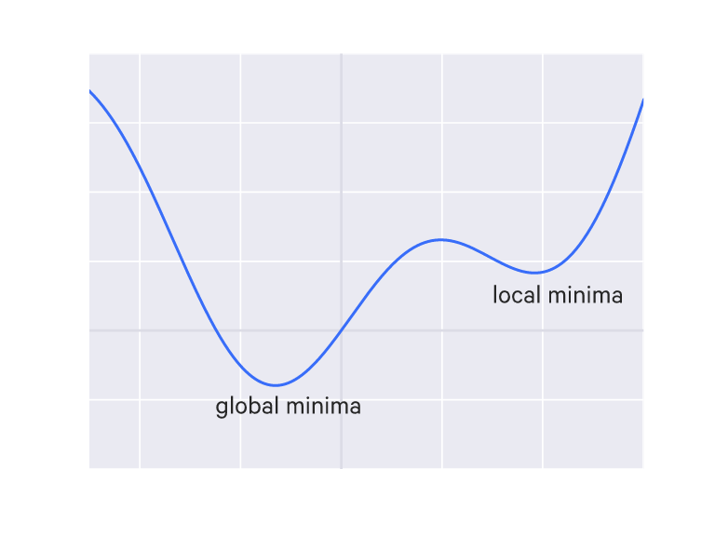
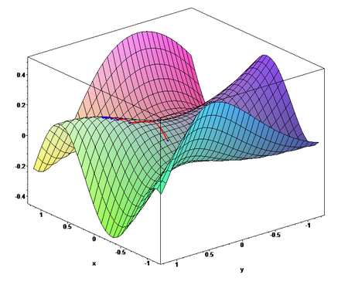
Local and Global minima
F(x)
x
Univariate: Curve
Multivariate: Surface

Slide 6
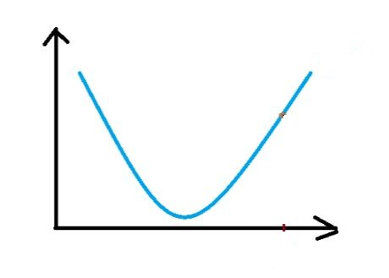
Gradient Descent
Role of gradient descent
To find the values of parameters that minimize an objective function
1. If we start from red circle, what is the direction of movement?
Ans: downward
2. How can we get that?
Ans: by looking at the derivative
3. What is the sign of $\frac{dF\left(θ \right)}{dθ }$ ?
Ans: positive
Then, which direction we should move?
Ans: - $\frac{dF\left(θ \right)}{dθ }$
How to change parameter to reach minimum?
$θ_{new}= θ_{old }$- $r ∗ \frac{dF\left(θ \right)}{dθ }$
r > 0 (scalar) is a parameter called rate constant
F($θ$)
$$θ$$
we want to reach here

Slide 7
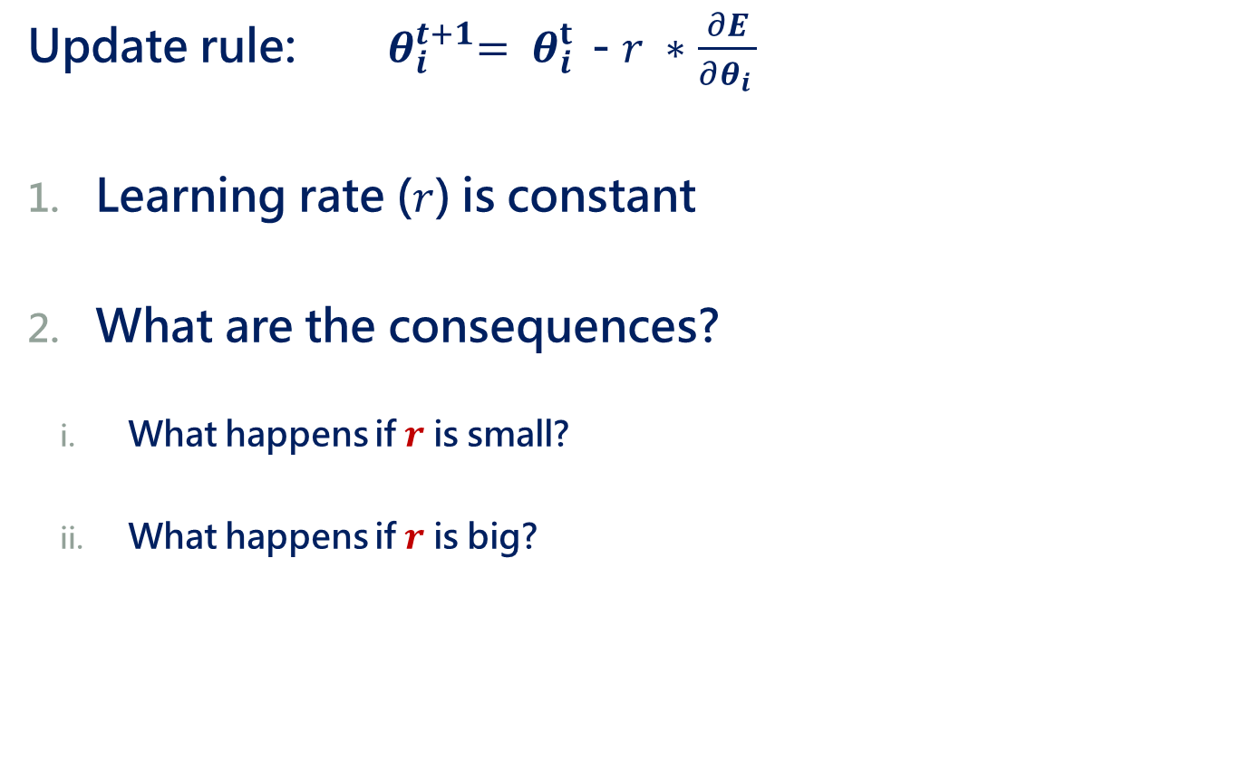
Limitations of Gradient Descent
Update rule: ${ θ}_{i}^{t+1}= θ_{i }^{t}$- $r ∗$ $\frac{∂E}{∂θ_{i }}$
Learning rate ($r$) is constant
What are the consequences?
What happens if $r$ is small?
What happens if $r$ is big?

Slide 8
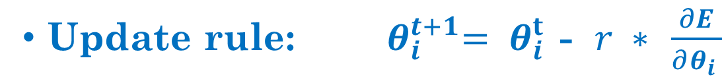
What happens for different $r$ ?
Small value of r => slow convergence

Slide 9
What happens for different $r$?
Small value of r
Large value of r
Oscillation / overshoots

Slide 10
Adaptive Gradient Descent

Slide 11
Adagrad
Main Idea:
Learning rate is different for different parameters
Learning rate of a parameter depends on its previous gradients

Slide 12

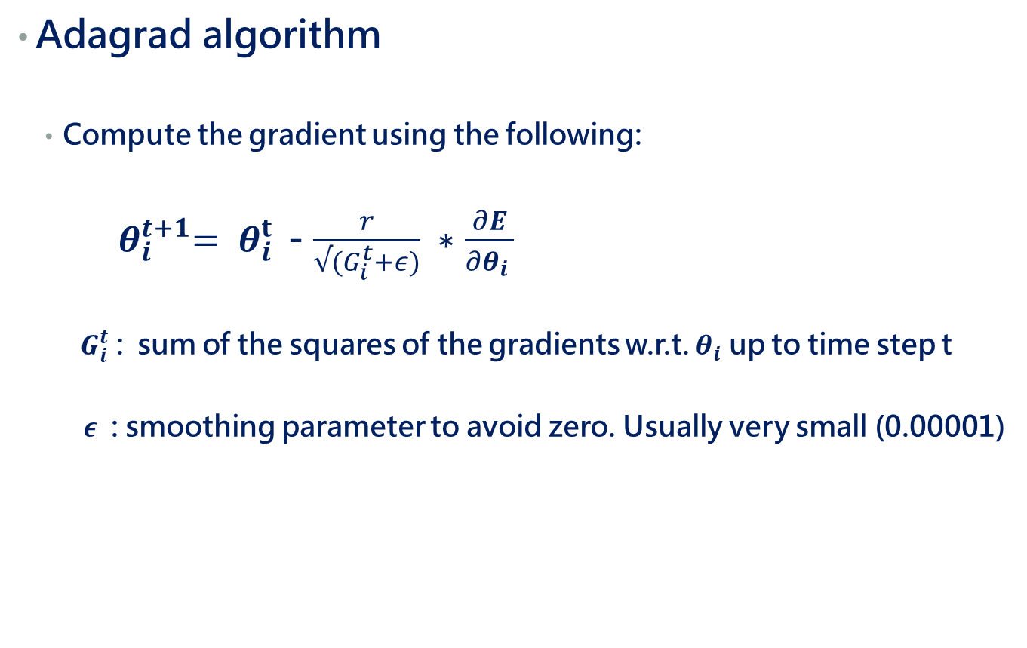
Adagrad
Adagrad algorithm
Compute the gradient using the following:
${ θ}_{i}^{t+1}= θ_{i }^{t}$- $\frac{r}{√(G_{i}^{t}+ε)} ∗$ $\frac{∂E}{∂θ_{i }}$
$G_{i}^{t}$ : sum of the squares of the gradients w.r.t. $θ_{i}$ up to time step t
$ε$ : smoothing parameter to avoid zero. Usually very small (0.00001)
${ ( Standard sgd: θ}_{i}^{t+1}= θ_{i }^{t}$- r $∗$ $\frac{∂E}{∂θ_{i }}$ )

Slide 13
Adagrad
Adagrad algorithm
Compute the gradient using the following:
${ θ}_{i}^{t+1}= θ_{i }^{t}$- $\frac{r}{√(G_{i}^{t}+ε)} ∗$ $\frac{∂E}{∂θ_{i }}$
$G_{i}^{t}$ : sum of the squares of the gradients w.r.t. $θ_{i}$ up to time step t
$ε$ : smoothing parameter to avoid zero. Usually very small (0.00001)

Slide 14
Adaptive Moment Estimation (ADAM)

Slide 15
Adaptive Moment Estimation: ADAM
Adaptive gradient for each parameter
Depends on two quantities
Decaying average of past gradients
Decaying average of past squared gradients

Slide 16
Adaptive Moment Estimation: ADAM
Adaptive gradient for each parameter
Depends on two quantities
Decaying average of past gradients
Decaying average of past squared gradients

Slide 17

Adaptive Moment Estimation: ADAM
Adaptive gradient for each parameter
Depends on two quantities
Decaying average of past gradients
Decaying average of past squared gradients

Slide 18
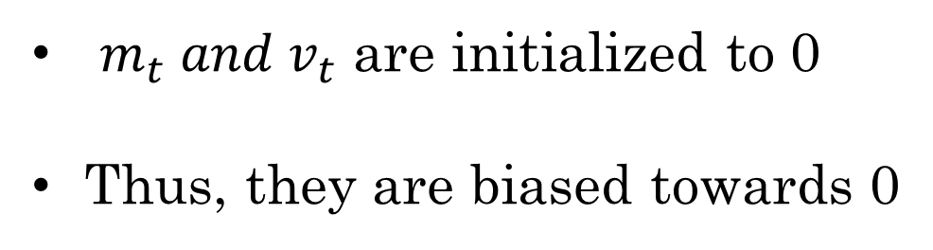
Adjustments for Bias Correction
$m_{t} and v_{t}$ are initialized to 0
Thus, they are biased towards 0

Slide 19
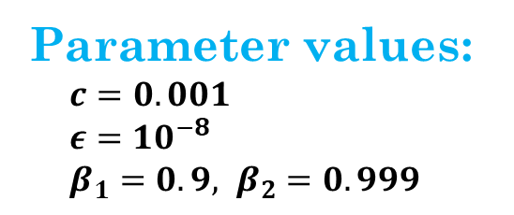
Final Update Rule
Parameter values:
$c=0.001$
$ε=10^{−8}$
$β_{1}=0.9, β_{2}=0.999$

Slide 20
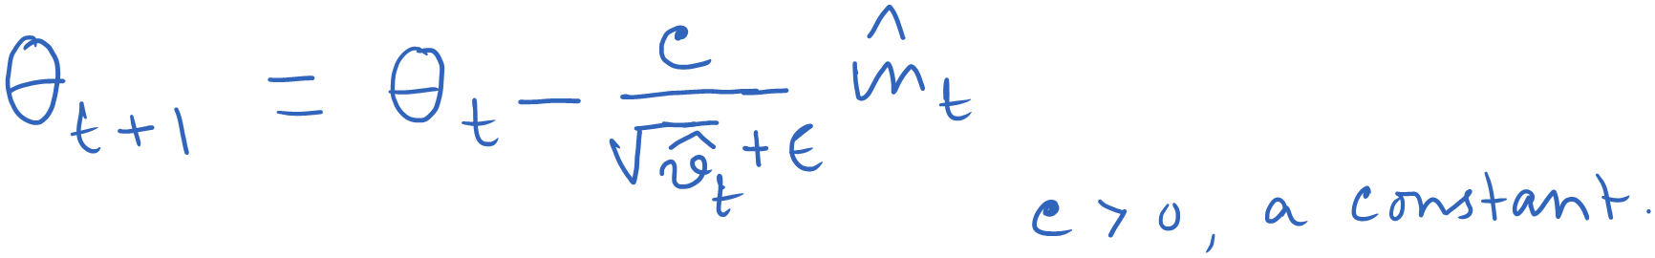
ADAM: How does it adapt?

Slide 21
ADAM: How does it adapt?

Slide 22
Deep Neural Network

Slide 23
Motivation

Slide 24
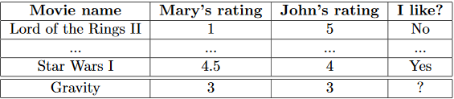
A Motivating Problem
Movie recommendation:
You have two friends John and Mary. You have prior data telling the movies you liked or disliked that they rated. Now a new movie named ‘gravity’ has been released that they rated and you want to decide whether you should watch it.

Slide 25
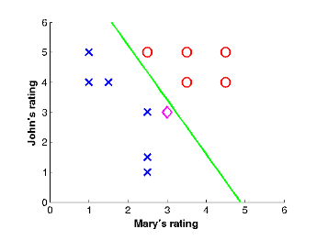
Movie Recommendation
Plot of the data:
You liked
New movie
You disliked
Observation: the classes can be separated by straight line

Slide 26
Movie Recommendation
How can you predict the label for new movie, gravity?
Answer: Logistic regression

Slide 27





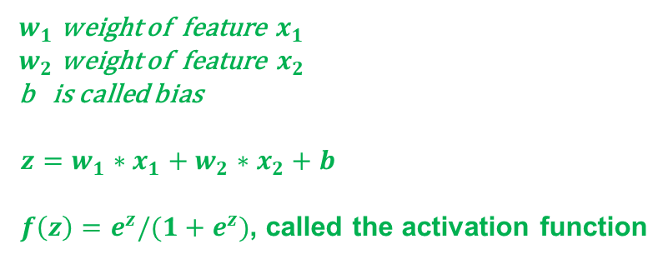

Logistic Regression: Graphical View
represented by z
$$x_{1}$$
$$w_{1}$$
f(z)
output
$$x_{2}$$
$$w_{2}$$
$$b$$
$w_{1}$ weight of feature ${ x}_{1}$
$w_{2}$ weight of feature $x_{2}$
b is called bias
$z=w_{1}∗x_{1}+w_{2}∗x_{2}+b$
$f\left(z\right)=e^{z}/(1+e^{z})$, called the activation function
For this sample, what will be value of z?
positive or negative?
What will be the output given by f(z)?
> 0.5
What the logistic regression is doing actually?
Given an input sample, it is telling which side of the straight line the sample lies.

Slide 28
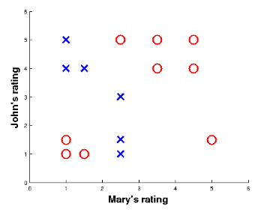
Limitations of Linear Decision Function
Now consider a data like this:
The decision function involves two straight lines
Thus, we need to combine information from two straight lines

Slide 29











Addressing Non-linearity
Moral of the story:
Hidden nodes help make decision in complex cases
In classification, the complex case means highly non-linear decision boundary that separates the classes
More hidden layers you take, more complex decision your model can make
Here is a good network
$$x_{1}$$
$$w_{1}$$
f
$$w_{5}$$
$$w_{2}$$
$$b_{1}$$
f
output
$$w_{3}$$
$$x_{2}$$
f
$$w_{6}$$
$$w_{4}$$
$$b_{2}$$
The shaded nodes are called hidden nodes
Each hidden node corresponds to one straight line in the data

